Slide 1
CE301 Challenge Week

Slide 2
Project objectives
Motivation for the project
The project consists of researching and developing new approaches on how to assess blood samples for malaria, this was always one of the things that I was very interested in as it combines machine learning and biology in its own rights. With malaria being a serious infectious disease, which has plagued humanity for a very long time, I believe developing new classification and detection methods can have the potential to turn the tide in the fight against malaria and the contribution to this cause is invaluable for the cause itself and for my own experience.
This project will also help me develop and understanding of this academic field which I think will prove invaluable in the future, and as this topic is deep within the scope of scientific academic research it will help me get a good understanding of the methodology on how these scientific methods are being carried out and how the academic papers themselves are written.
Furthermore, this project has potential to provide a new perspective into the field of malaria in terms of the approach on how to classify red blood cells and how to detect the malaria infected red blood cells with a reasonable amount of confidence. This project can also introduce non-industry standard techniques into how the problem is being tackled in the first place, such as using genetic programming to create the classifier and developing my own CNN with different attributes than the industry standard recommends which would ultimately push the research forward.
In conclusion I believe that this project is well suited for my goals and interests and that it will be possible for me to create a good classifier and detection architecture aiding the fight against malaria.

Slide 3
Project objectives
Plan for remainder of the project
Develop a detection and classifier system
Optimize classifier and detection to a sufficient standard
Formulate project findings and compare to peer-reviewed research
Deliver a high-quality deliverable and the end of the project with good documentation
Be able to run the classification and detection algorithms on a smartphone
The implementation plan for this project is as follows; firstly, the main goal for the project is to develop sufficient detection and classifier methods which would allow me to understand the different methodologies used for the development, this would in turn lead to trying out different approaches until the most optimal and accurate method can be achieved. Secondly, the goal of the project is to be able to formulate these findings effectively and do enough academic research to understand that the approach used is beneficial to the problem as a whole. Thirdly, if possible, the project could be ported onto an application which can be used on your smartphone to take pictures of malaria samples through a commonly accessible light microscope in places of need.
The risks for the projects are summarized in the risk assessment form however the most influential risks are to be able to finish the project on time to a sufficient standard and to be able to continuously improve its quality until, again, a sufficient standard is reached.

Slide 4
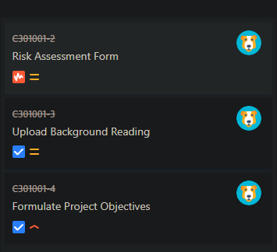

Project objectives
Project management approach
One of the most crucial approaches is to be able to sufficiently document all research and all progress onto Jira with sufficient evidence being provided on Gitlab.
With regular updates to Jira the progress of the development process can be tracked effectively and therefore the Waterfall management approach would be the most fitting. This is because the project goal is clearly defined, and the development should be sequential.

Slide 5
Background reading
Clustering-Based Dual Deep Learning Architecture for Detecting Red Blood Cells in Malaria Diagnostic Smears (IEEE JOURNAL OF BIOMEDICAL AND HEALTH INFORMATICS, VOL. 25, NO. 5, MAY 2021)
Invasion of Red Blood Cells by Malaria Parasites (Alan F. Cowman1, * and Brendan S. Crabb1, * 1The Walter and Eliza Hall Institute of Medical Research, Melbourne 3050, Australia *Contact: cowman@wehi.edu.au (A.F.C.); crabb@wehi.edu.au (B.S.C.) DOI 10.1016/j.cell.2006.02.006)
Estimating malaria parasitemia from blood smear images (Halim et al, Proceedings of the International Conference on Control, Automation, Robotics and Vision, Jan 2006)
An automatic device for detection and classification of malaria parasite species in thick blood film (Kaewkamnerd et al, BMC Bioinformatics, Volume 13, 2012)
Automated image processing method for the diagnosis and classification of malaria on thin blood smears (N. E. Ross and C. J. Pritchard and D. M. Rubin and A. G. Dus\'e, Medical and Biological Engineering and Computing, Volume 44, Number 5, 2006)

Slide 6
Clustering-Based Dual Deep Learning Architecture for Detecting Red Blood Cells in Malaria Diagnostic Smears (IEEE JOURNAL OF BIOMEDICAL AND HEALTH INFORMATICS, VOL. 25, NO. 5, MAY 2021)
Uses dual deep learning architecture which can detect red blood cells in thin blood smears
RBCNet architecture uses cell clustering instead of region proposals [1]
The problem with traditional malaria screening methods such as; adaptive histograms, Zack thresholding is that they tend to fail when presented with challenging conditions since they depend on criteria such as light intensity and energy [2]
The motivation behind this project is to reduce the computationally expensive cost of object detection networks on large thin smear microscopy
Traditional methods such as Watershed or Active contour suffer from up to six times higher standard deviation than the methods used by this paper, where methods such as Active contour suffer from under or over-segmentation which happens in regions with challenging light conditions [3]
This is where the U-Net architecture is introduced which extracts foreground masks from cell images, which is then passed to the R-CNN architecture which refines cell clusters into individual cells, [4] the U-Net architecture basically guides the detection process by providing the CNN with robust candidates for analysis, this helps battle problematic images with large number of cells and dense amount of cell clusters.
The data set consists of human patients and the slides were photographed with a smartphone camera
With the use the U-Net and R-CNN architectures, a robust solution is achieved as these methods outperform traditional cell detection methods and object detection deep learning methods [5]

Slide 7
Estimating malaria parasitemia from blood smear images (Halim et al, Proceedings of the International Conference on Control, Automation, Robotics and Vision, Jan 2006)
Estimating parasitemia from blood smears accounting for uncertain imaging conditions, the method consist of using a multi-stage estimation process which is based on pattern matching with parameter optimization and cross-validation against expected biological characteristics
The optimization method is capable of evaluating the samples before the infection status is carried out, this is critical as segmentation techniques used by previous technology such as; thresholding, morphology and transformations and dedicated data description models [6] prove to not be as successful as the optimization method carried out in this paper
The following are the problems related to techniques used in previous technology. Regarding thresholding, this does not account for uncertainty of the samples provided and therefore correct thresholds cannot be set in advance. Regarding applying morphological operations, the method suffers due to different cell shape variations and therefore cannot be correctly segmented. For model-based approaches, with the use of Bayes classifiers or regularized centroid transform, it is one of the most effective methods however suffers from the problem that if the data derivates from the model, it limits the applicability of the classifier.
The technique of compensation of image variability was used to achieve a reliable performance and achieves the actual classification of infected cells to be more stable. This allows us to take inspiration from this process in order to increase the accuracy of our predictions and have a more optimized classifier. [7]

Slide 8
An automatic device for detection and classification of malaria parasite species in thick blood film (Kaewkamnerd et al, BMC Bioinformatics, Volume 13, 2012)
Human inconsistency is one of the main reasons accurate classification of parasite species suffers in accuracy, with the development of image processing tools aimed at detection and classification of parasites in thick blood film this problem can be addressed as most inconsistencies occur in detection and classification in thin blood film
The goal of this study is to develop an automatic system for detection and classification of malaria parasite species in Giemsa-stained thick blood films. To date, a few automatic systems were developed to count numbers of parasites in thick blood films. To our knowledge, however, there is no automatic system that could classify species of malaria parasites in thick blood films especially for P. falciparum and P. vivax that are the two most prevalent species. [8]
With the use of tools aimed at thick blood film, the classification of the Pv (P. vivax, causes less serious malaria) parasite was 75% and the accuracy of the Pf (P. falciparum, causes severe malaria) parasite was 90%. The accuracy of the prototype in regard to detecting parasite-positive and parasite-negative blood film, the rate was measured at 95% and 68.5% accuracy respectively [9]
Conclusively this method can be used for both segmentation and classification of malaria on thick blood film, the analysis program could accurately classify parasite species, into Pf or Pv, and into positive or negative malaria samples

Slide 9
Automated image processing method for the diagnosis and classification of malaria on thin blood smears (N. E. Ross and C. J. Pritchard and D. M. Rubin and A. G. Dus\'e, Medical and Biological Engineering and Computing, Volume 44, Number 5, 2006)
The proposed advantage of using thin blood smears is that there is no loss of parasite during staining, the red blood cells are fixed, imaging artifacts are uncommon and most importantly the parasite morphology is not distorted which is vital for the classification process. [10]
The examination of the slides was carried out under oil-immersion, and under a light microscope with the magnification of 1000x. [10]
The system must have good sensitivity as sometimes low numbers of parasites are present on the slides, which could lead to a potentially non-accurate result. The system itself examines the red blood cell and determines if malaria is present or not, and if present the system determines the species of malaria (P. vivax, P. ovale, P. malarie, P. falciparum) [11]
The algorithm is an image classification problem, therefore takes the form of standard pattern recognition and classification. It consists of four stages: image acquisition, pre-processing, feature generation and classification. A morphological method is used to identify the malaria in the stained blood slides. [11]
The pre-processing part of the process removes background noise from the image and scales down the image by a factor of four to speed up the system. Then the image is filtered by a 5x5pixel median filter followed by a morphological area closing filter using a disk-shaped structure with a radius of 6 pixels. [12] Granulometry is then used to find out the size distribution of the cells which allows us to find out the estimated total of cells in the image [13]
For segmentation, thresholding is primarily being used (rather than edge detection, or watershed) and with the use of a histogram the thresholds can be established, one thresholds needs to be for the red blood cells and the other thresholds for the parasites. [14] Setting a global threshold is not accurate enough and the sensitivity would be too low. Finding local thresholds in RBCs allows us to use both a local and global threshold
For classification, a tree classifier with two nodes using BFF neural networks determines whether a cell is infected, and if so, the species of the malaria. Potential parasites are segmented from the image with a sensitivity of 92% and a PPV of 40%. The classifier is able to positively identify malaria parasites with a sensitivity of 85% and a PPV of 81%. [15]

Slide 10
References:
[1] Y. M. Kassim , K. Palaniappan , F. Yang , M. Poostchi, N. Palaniappan, R. J Maude , S. Antani , and S. Jaeger, “Clustering-Based Dual Deep Learning Architecture for Detecting Red Blood Cells in Malaria Diagnostic Smears” IEEE JOURNAL OF BIOMEDICAL AND HEALTH INFORMATICS, VOL. 25, NO. 5, pp. 1, MAY 2021
[2] Y. M. Kassim , K. Palaniappan , F. Yang , M. Poostchi, N. Palaniappan, R. J Maude , S. Antani , and S. Jaeger, “Clustering-Based Dual Deep Learning Architecture for Detecting Red Blood Cells in Malaria Diagnostic Smears” IEEE JOURNAL OF BIOMEDICAL AND HEALTH INFORMATICS, VOL. 25, NO. 5, pp. 2, MAY 2021
[3] Y. M. Kassim , K. Palaniappan , F. Yang , M. Poostchi, N. Palaniappan, R. J Maude , S. Antani , and S. Jaeger, “Clustering-Based Dual Deep Learning Architecture for Detecting Red Blood Cells in Malaria Diagnostic Smears” IEEE JOURNAL OF BIOMEDICAL AND HEALTH INFORMATICS, VOL. 25, NO. 5, pp. 7, MAY 2021
[4] Y. M. Kassim , K. Palaniappan , F. Yang , M. Poostchi, N. Palaniappan, R. J Maude , S. Antani , and S. Jaeger, “Clustering-Based Dual Deep Learning Architecture for Detecting Red Blood Cells in Malaria Diagnostic Smears” IEEE JOURNAL OF BIOMEDICAL AND HEALTH INFORMATICS, VOL. 25, NO. 5, pp. 10, MAY 2021
[5] Y. M. Kassim , K. Palaniappan , F. Yang , M. Poostchi, N. Palaniappan, R. J Maude , S. Antani , and S. Jaeger, “Clustering-Based Dual Deep Learning Architecture for Detecting Red Blood Cells in Malaria Diagnostic Smears” IEEE JOURNAL OF BIOMEDICAL AND HEALTH INFORMATICS, VOL. 25, NO. 5, pp. 11, MAY 2021
[6] S. Halim, T. R. Bretschneider, Y. Li, P. R. Preiser, C. Kuss,” Estimating Malaria Parasitaemia from Blood Smear Images” , Proceedings of the International Conference on Control, Automation, Robotics and Vision, pp. 2, Jan 2006
[7] S. Halim, T. R. Bretschneider, Y. Li, P. R. Preiser, C. Kuss, “Estimating Malaria Parasitaemia from Blood Smear Images”, Proceedings of the International Conference on Control, Automation, Robotics and Vision, pp. 5, Jan 2006
[8] S. Kaewkamnerd1 , C.Uthaipibull2 , A. Intarapanich1 , M. Pannarut1 , S. Chaotheing2 , S. Tongsima2*, “An automatic device for detection and classification of malaria parasite species in thick blood film”, Asia Pacific Bioinformatics Network (APBioNet) Eleventh International Conference on Bioinformatics (InCoB2012), pp. 3-4, October 2012
[9] S. Kaewkamnerd1 , C.Uthaipibull2 , A. Intarapanich1 , M. Pannarut1 , S. Chaotheing2 , S. Tongsima2*, “An automatic device for detection and classification of malaria parasite species in thick blood film”, Asia Pacific Bioinformatics Network (APBioNet) Eleventh International Conference on Bioinformatics (InCoB2012), pp.1, October 2012
[10] N. E. Ross and C. J. Pritchard and D. M. Rubin and A. G. Dus\’e, “Automated image processing method for the diagnosis and classification of malaria on thin blood smears”, Medical and Biological Engineering and Computing, Volume 44, Number 5, pp. 2, 2006
[11] N. E. Ross and C. J. Pritchard and D. M. Rubin and A. G. Dus\’e, “Automated image processing method for the diagnosis and classification of malaria on thin blood smears”, Medical and Biological Engineering and Computing, Volume 44, Number 5, pp. 2, 2006
[12] N. E. Ross and C. J. Pritchard and D. M. Rubin and A. G. Dus\’e, “Automated image processing method for the diagnosis and classification of malaria on thin blood smears”, Medical and Biological Engineering and Computing, Volume 44, Number 5, pp. 4, 2006
[13] N. E. Ross and C. J. Pritchard and D. M. Rubin and A. G. Dus\’e, “Automated image processing method for the diagnosis and classification of malaria on thin blood smears”, Medical and Biological Engineering and Computing, Volume 44, Number 5, pp. 3, 2006
[14] N. E. Ross and C. J. Pritchard and D. M. Rubin and A. G. Dus\’e, “Automated image processing method for the diagnosis and classification of malaria on thin blood smears”, Medical and Biological Engineering and Computing, Volume 44, Number 5, pp. 4, 2006
[15] N. E. Ross and C. J. Pritchard and D. M. Rubin and A. G. Dus\’e, “Automated image processing method for the diagnosis and classification of malaria on thin blood smears”, Medical and Biological Engineering and Computing, Volume 44, Number 5, pp. 10, 2006

Slide 11
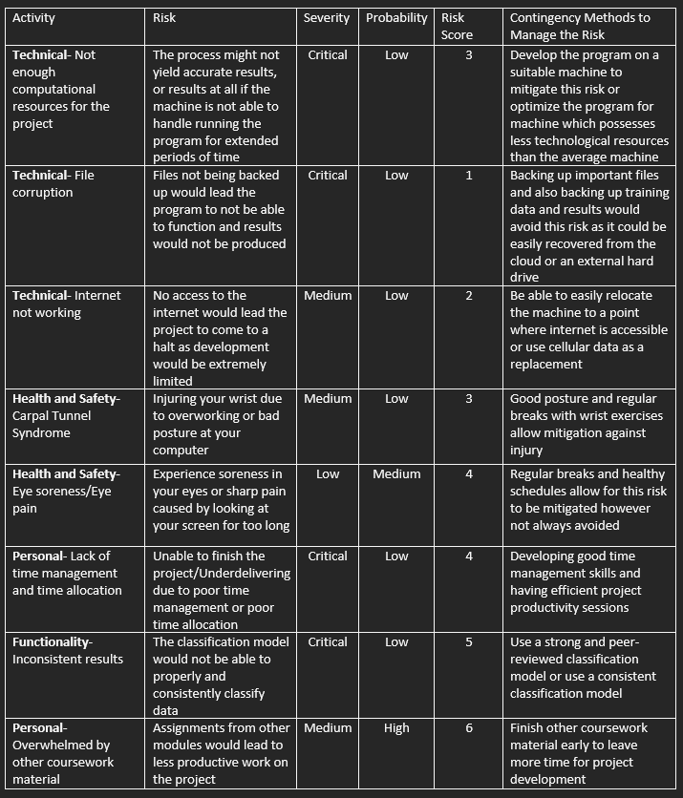
Risk Assessment form

Slide 12
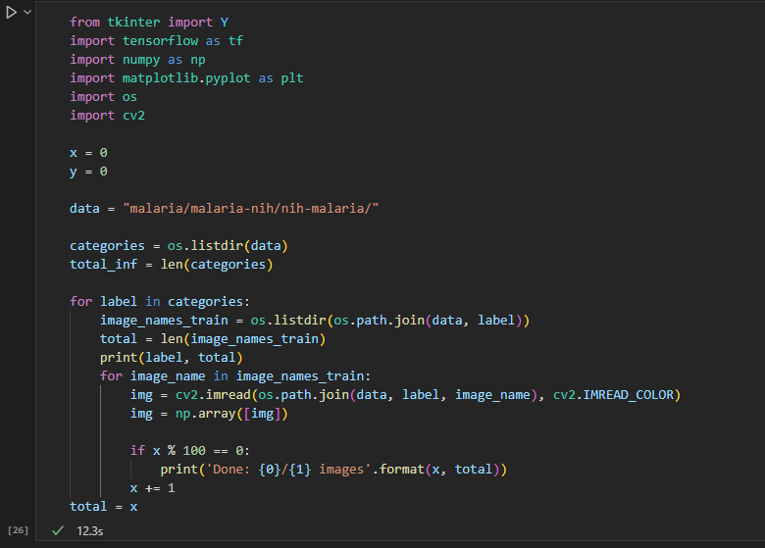
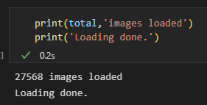
Technical achievements

